Slide 1
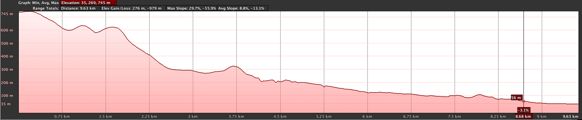
Boundary of Pf/Qpf
Boundary of Mpb/Pf
Boundary of Ppf/Qpf
Fault
EPGFZ
Map edge
20-30 N
Fault
15-20 N
Fault
Fault
Fault
Fault
Boundary of Qpf/Qphf
Boundary of Lmst/Mpb
Boundary of Pf/Ppf

Slide 2
